Slide 1

AuVeDT
Auburn Vehicle Dynamics Toolkit

Slide 2
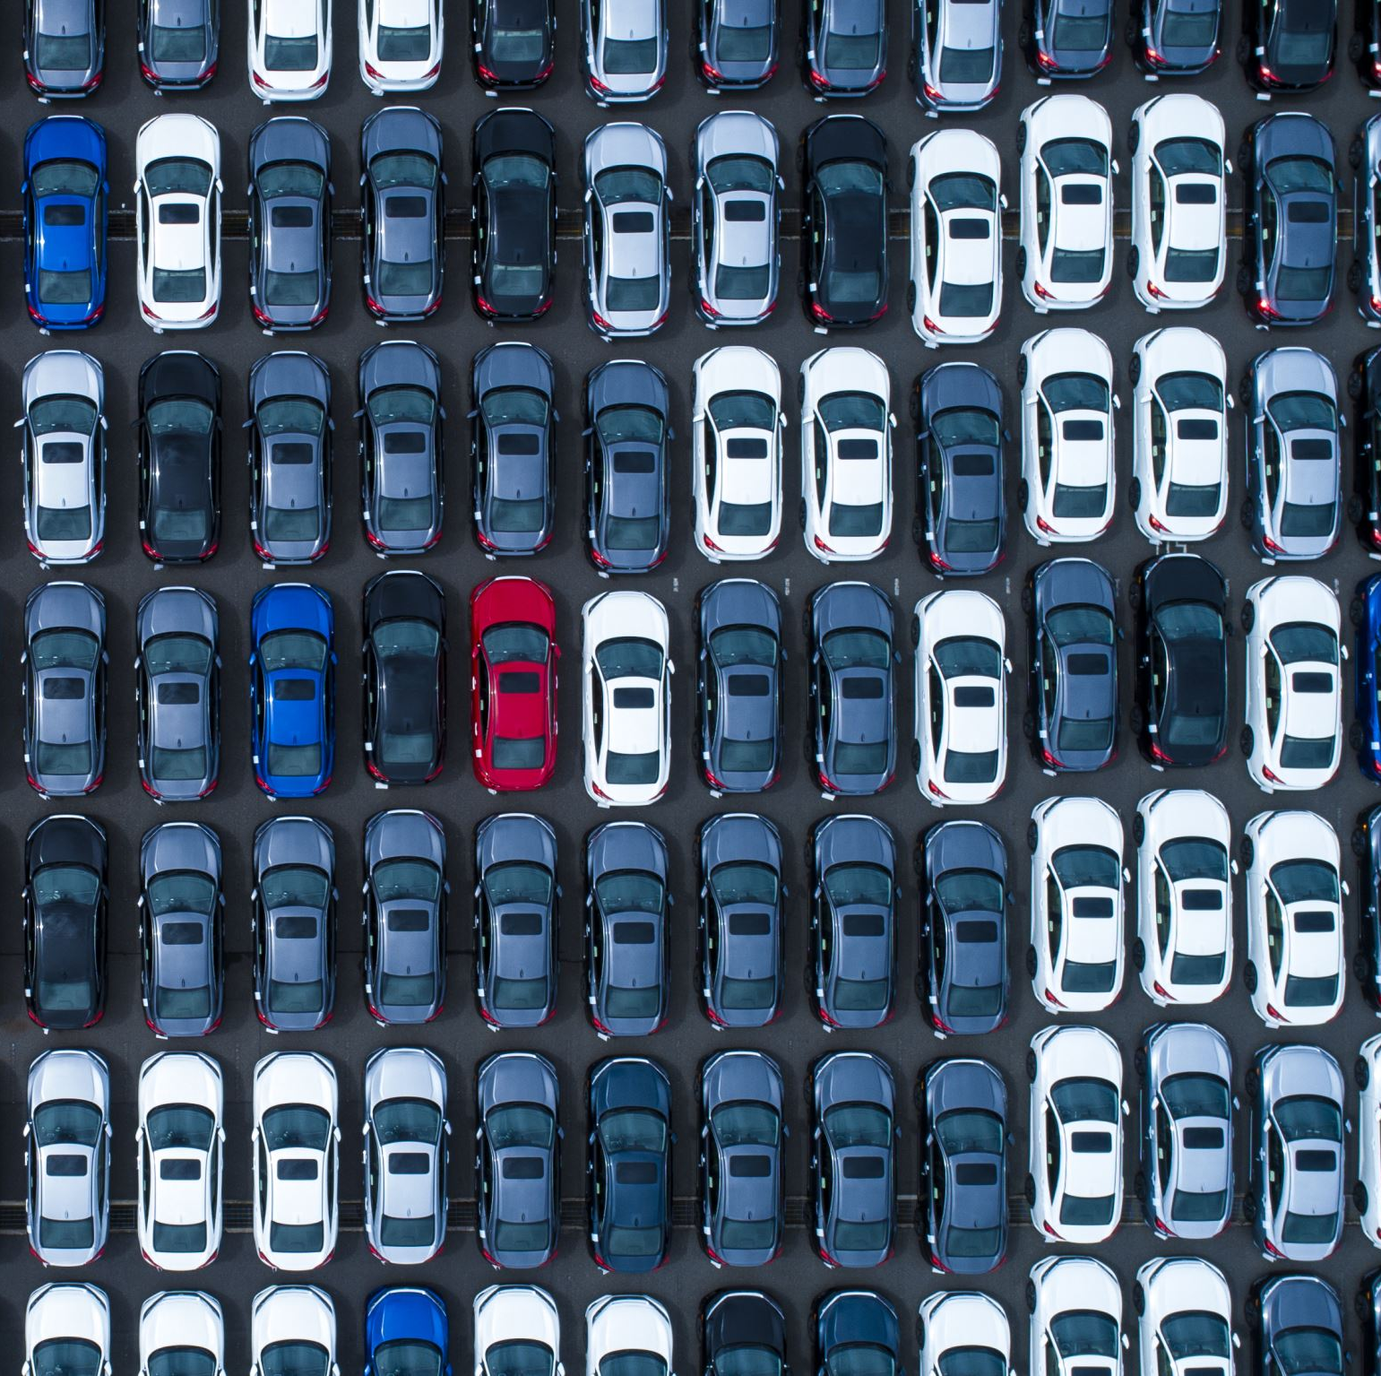
Introduction
Vehicle Kinematics are hard to model due to a lack of information available online.
EVs such as the Tesla Model S has set new standards for production car coefficient of drag (0.208)!
Modeling effects of drag on a drive is helpful to optimize commercial route planning and speed (e.g. UPS trucks)

Slide 3
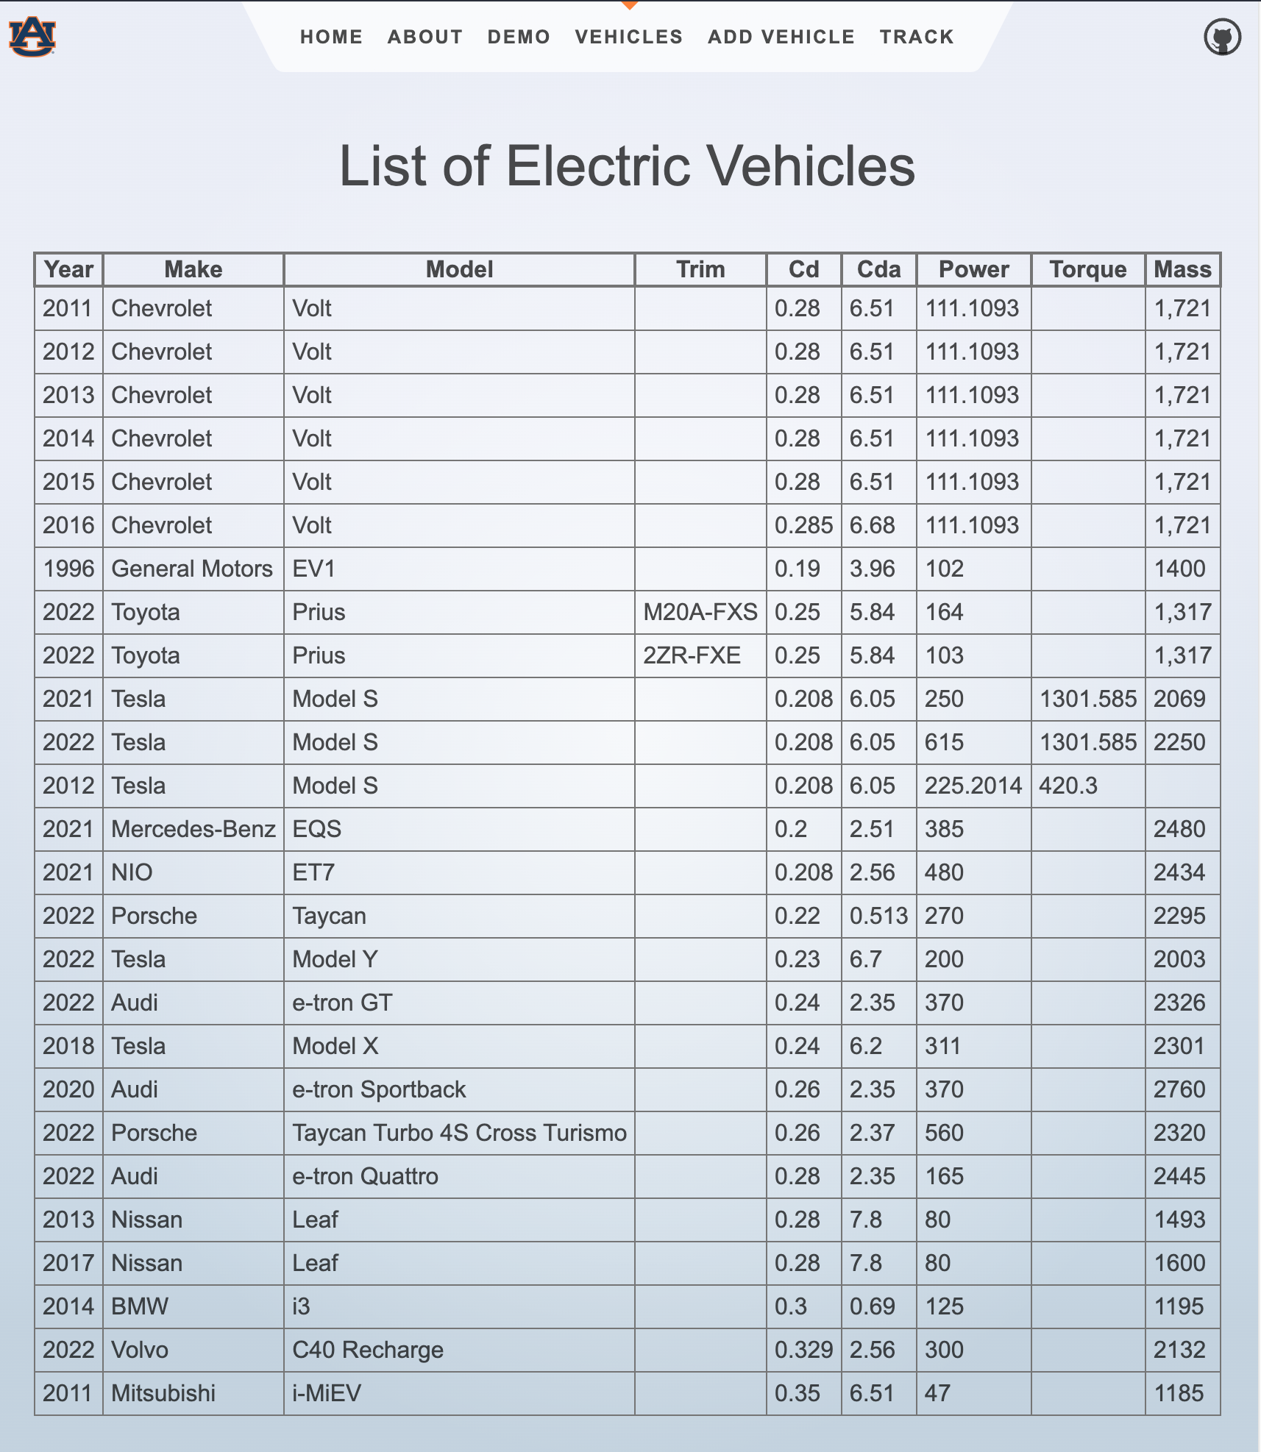
Project Description
Problem: It is very difficult for researchers and consumers to easily find technical specifications for various vehicles without prior industry relationships.
Answer: Create a website and application programming interface (API) for researchers to to consult.
(Stretch Goal) Demonstrate uses through a web application Modeling and Simulation Tool

Slide 4
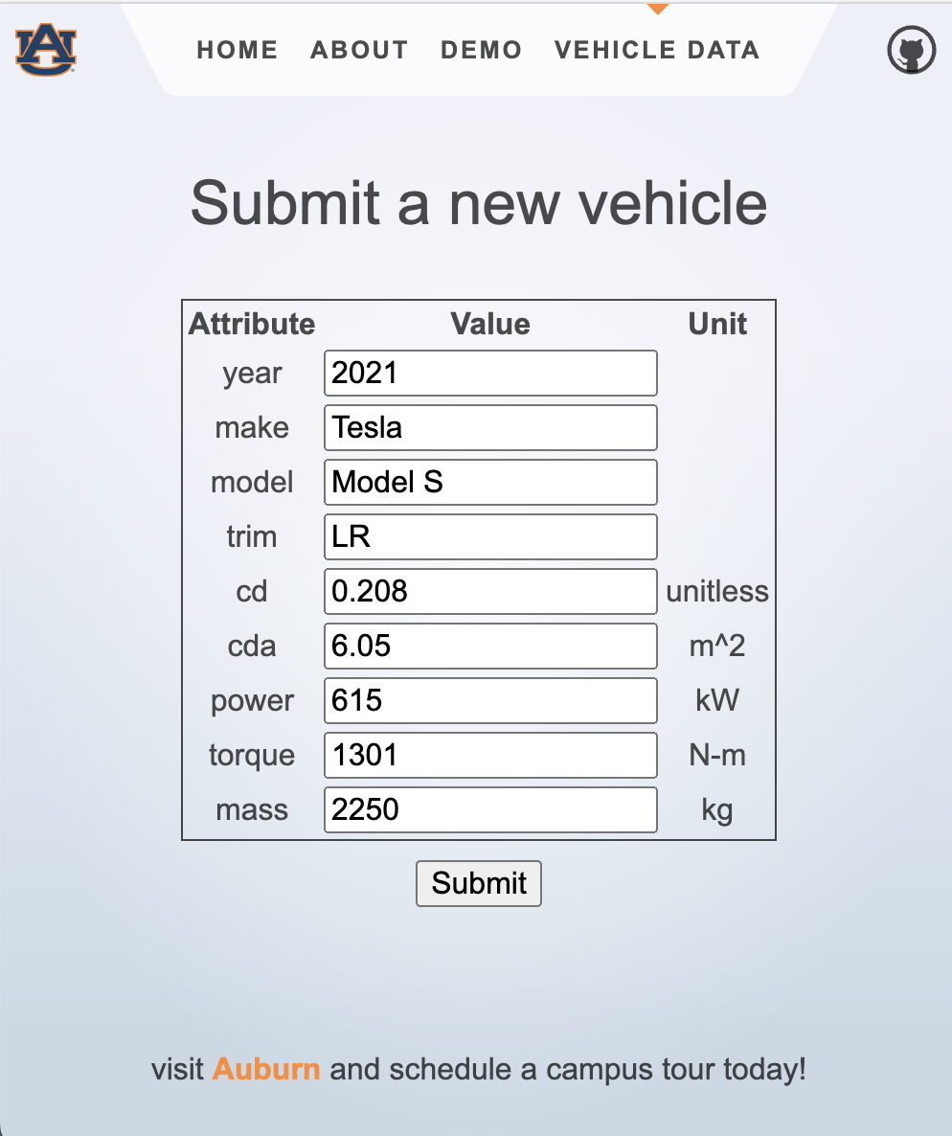
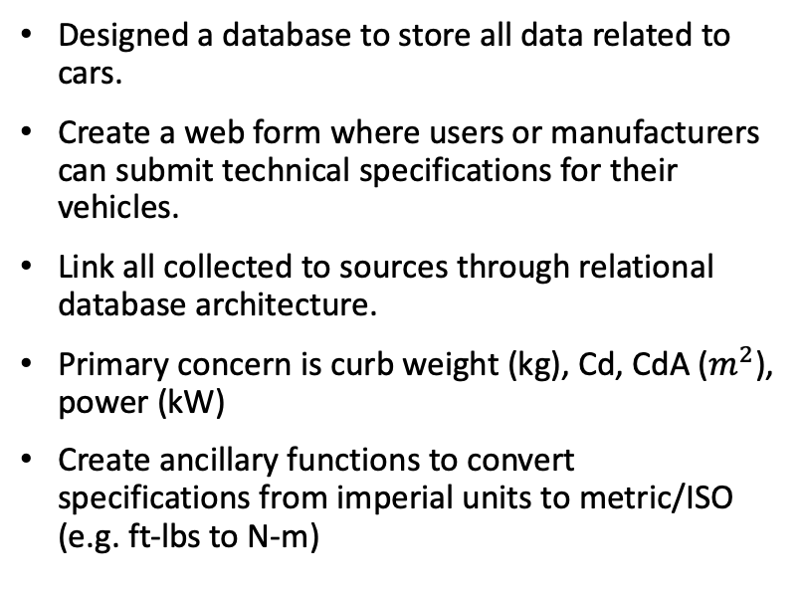
Vehicle Data
Designed a database to store all data related to cars.
Create a web form where users or manufacturers can submit technical specifications for their vehicles.
Link all collected to sources through relational database architecture.
Primary concern is curb weight (kg), Cd, CdA ($m^{2}$), power (kW)
Create ancillary functions to convert specifications from imperial units to metric/ISO (e.g. ft-lbs to N-m)

Slide 5
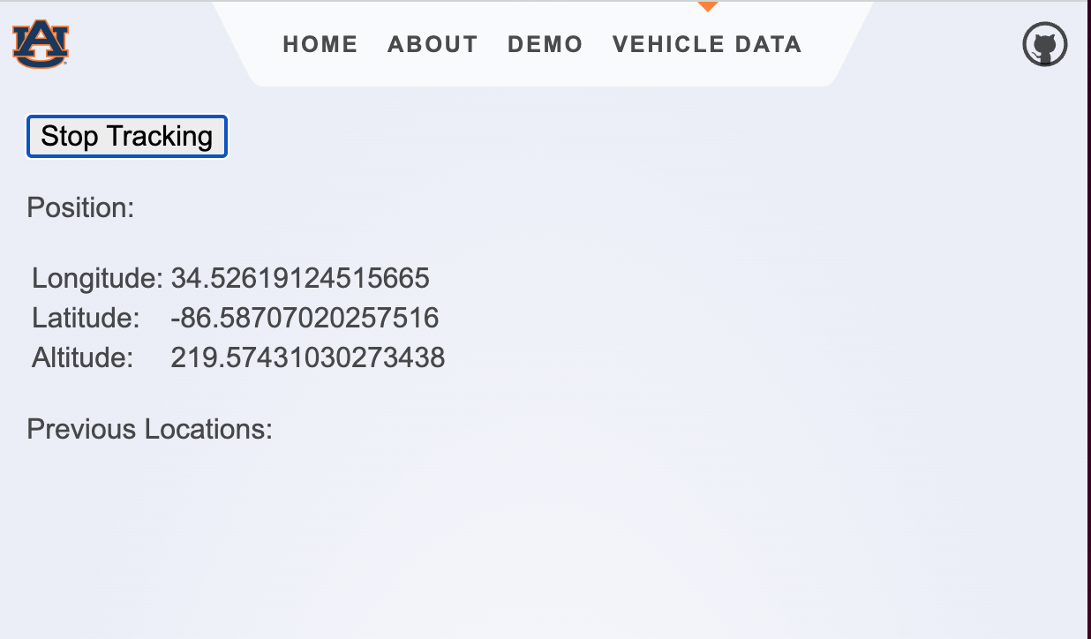
Drive Modeling
Tasks
Collect data from real drives using GPS (currently using Matlab Mobile on iPhone 14 Pro and beta Web App capability)
Convert latitude, longitude, altitude (LLA) to Earth Centered, Earth Fixed (ECEF)
Calculate speed/velocity
Use as input to model for vehicle dynamics

Slide 6

Determining Speed

Slide 7
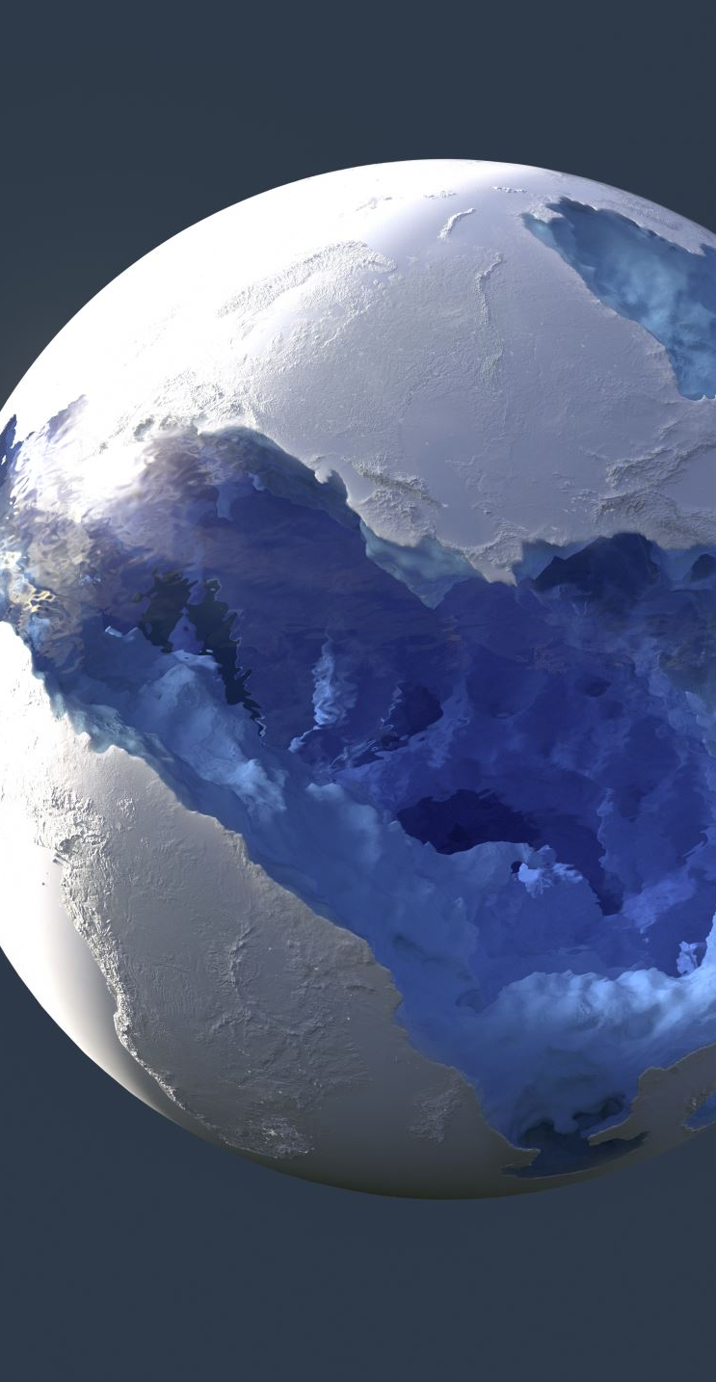
Determining Speed (cont.)
Typical GPS coordinates are given in LLA (WGS84). This is a model established in 1984 for the earth’s ellipsoidal shape.
Typically an ellipsoid function to convert to Earth. Centered-Earth Fixed.
Earth Centered, Earth Fixed (ECEF) is a cartesian model of space with the center of the earth as the origin. Points on the surface of the earth are mapped to their cartesian coordinates.
Math in ECEF is much easier than in WGS84 (similar to spherical but complicated)

Slide 8
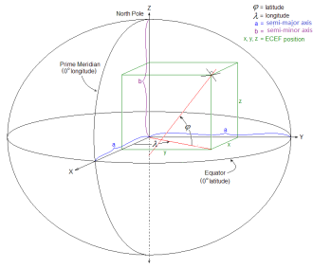
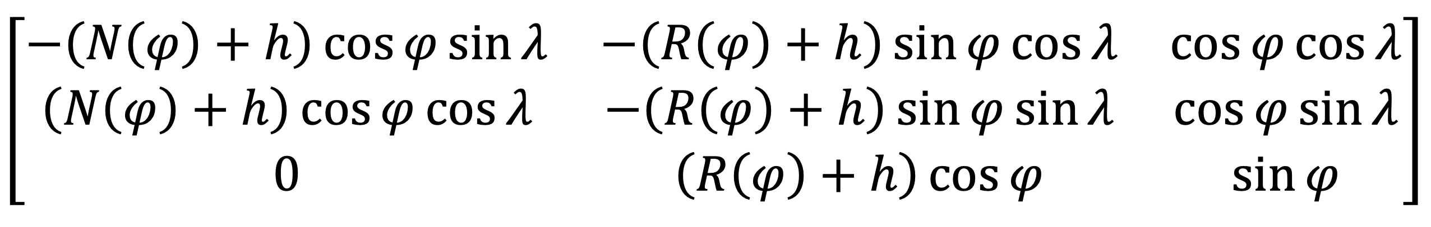
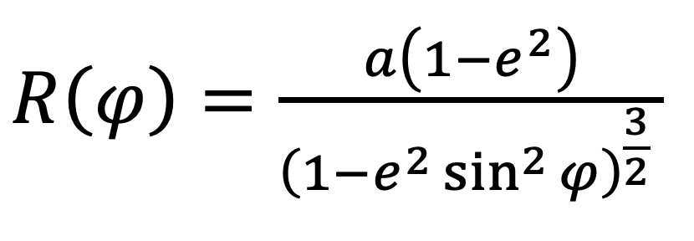
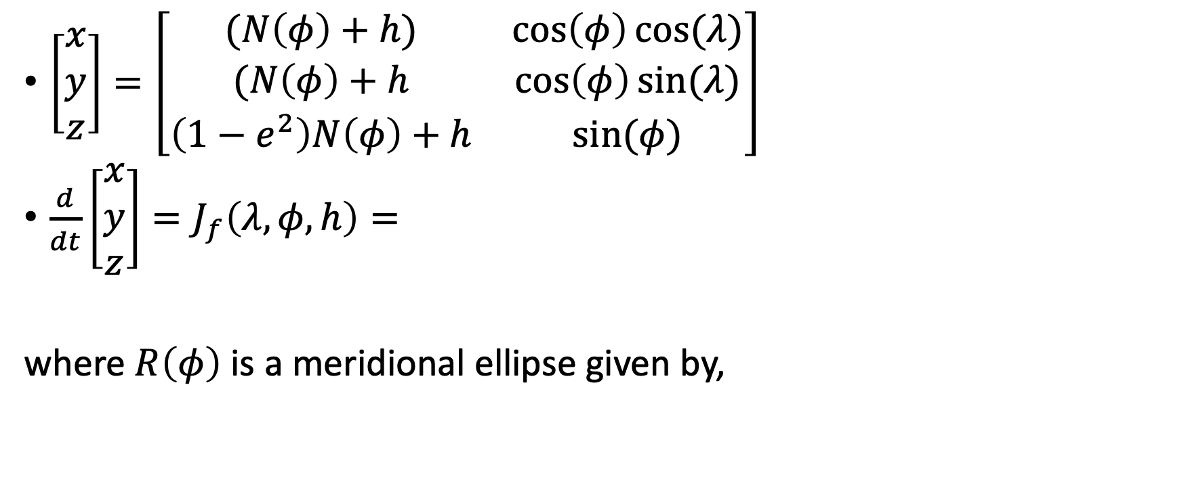
Determining Speed (cont.)
$\left[\begin{matrix}x \\ y \\ z\end{matrix}\right]=\left[\begin{matrix}(N\left(φ\right)+h) & \cos\left(φ\right)cos⁡(λ) \\ (N\left(φ\right)+h & \cos\left(φ\right)sin⁡(λ) \\ \left(1−e^{2}\right)N\left(φ\right)+h & sin⁡(φ)\end{matrix}\right]$
$\frac{d}{dt}\left[\begin{matrix}x \\ y \\ z\end{matrix}\right]=J_{f}\left(λ, φ, h\right)=$
where $R\left(φ\right)$ is a meridional ellipse given by,

Slide 9
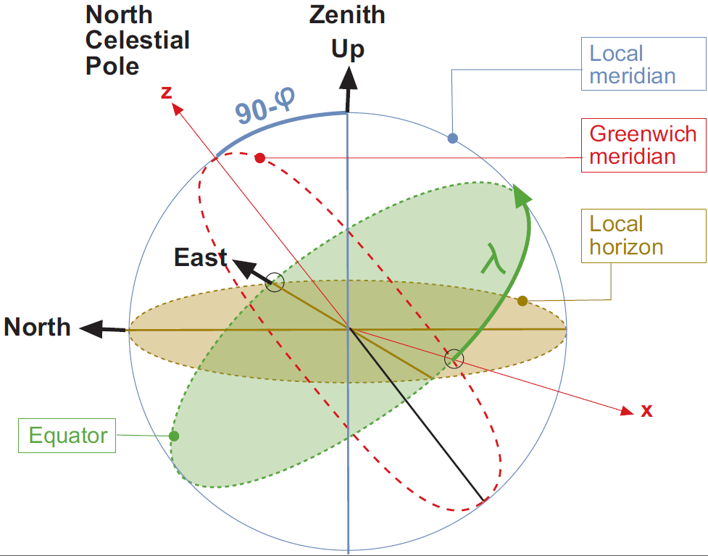
East North Up – Tangential Coordinates

Slide 10


Practical Implementation
PyProj is a library for converting from WGS84 to ECEF (Python).
ecef-projector is a library used for Node.js in webapp
From ECEF, we simply take derivative of the position
$$\left|\frac{d\vec{P}}{dt}\right|=\frac{d}{dt}\left|\left[\begin{matrix}0 & ⋯ & P_{x_{tf}} \\ 0 & ⋱ & P_{y_{tf}} \\ 0 & ⋯ & P_{z_{tf}}\end{matrix}\right]\right|$$
where each iteration of the collected data has period $dt$

Slide 11

Combining Real GPS drives with Vehicle Performance

Slide 12
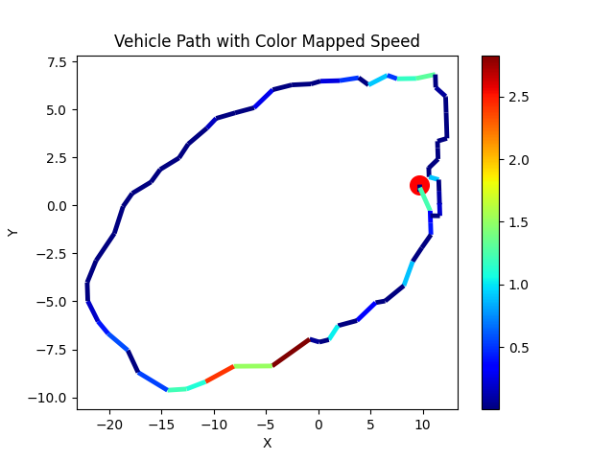
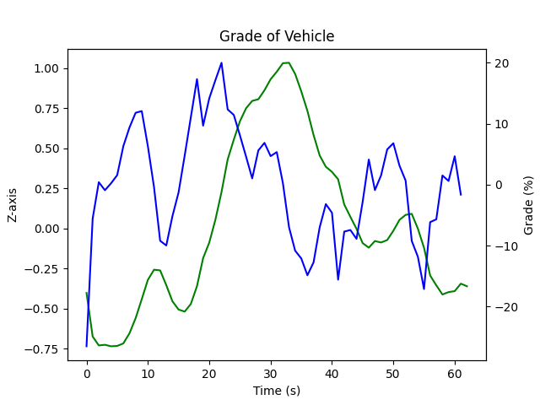
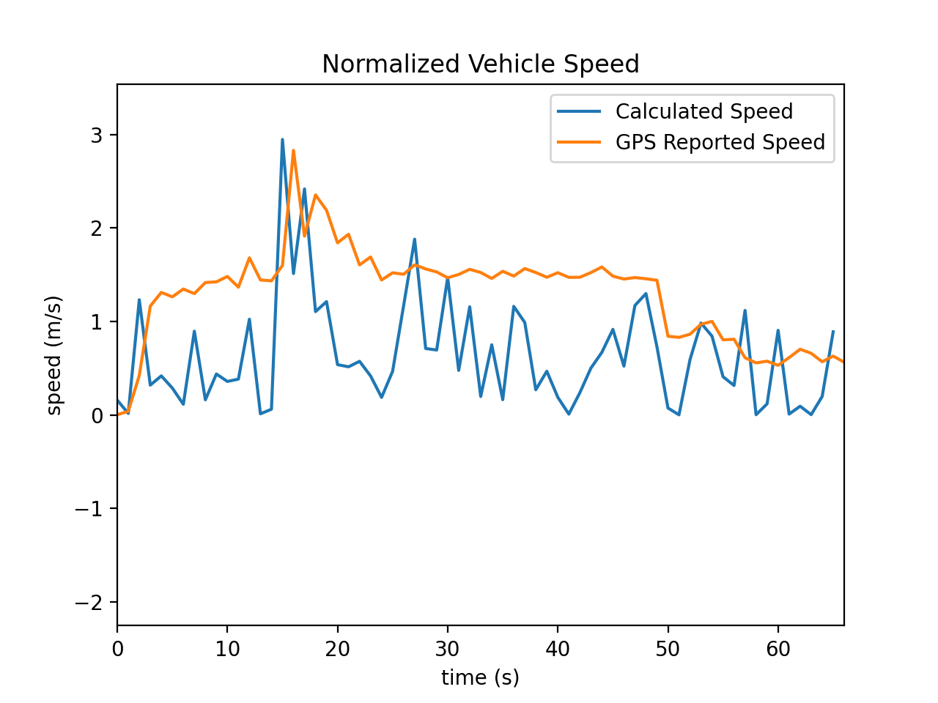
Results

Slide 13
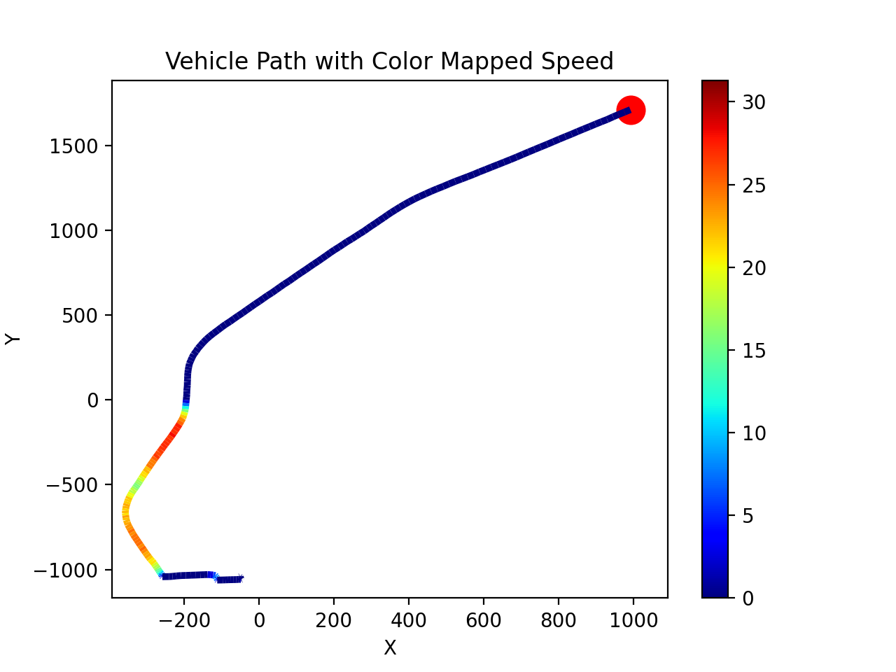
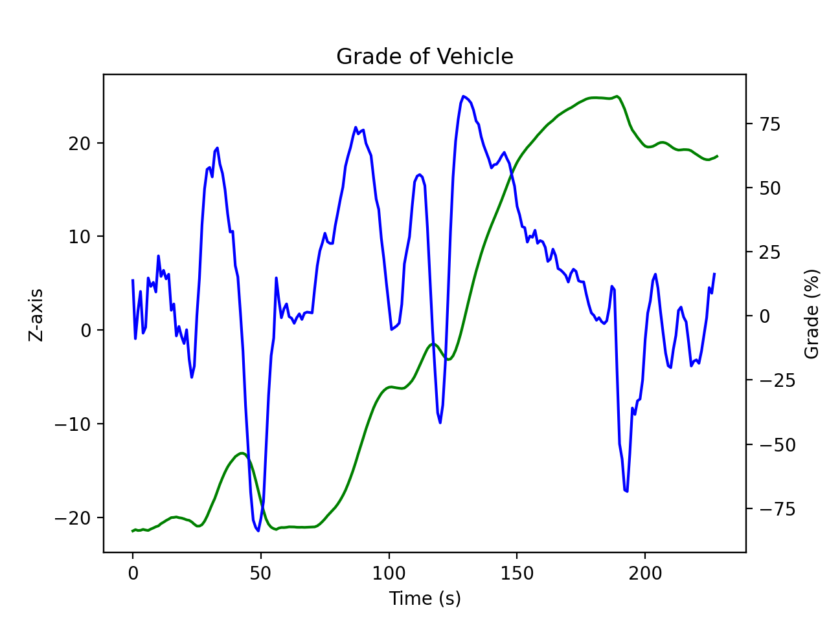
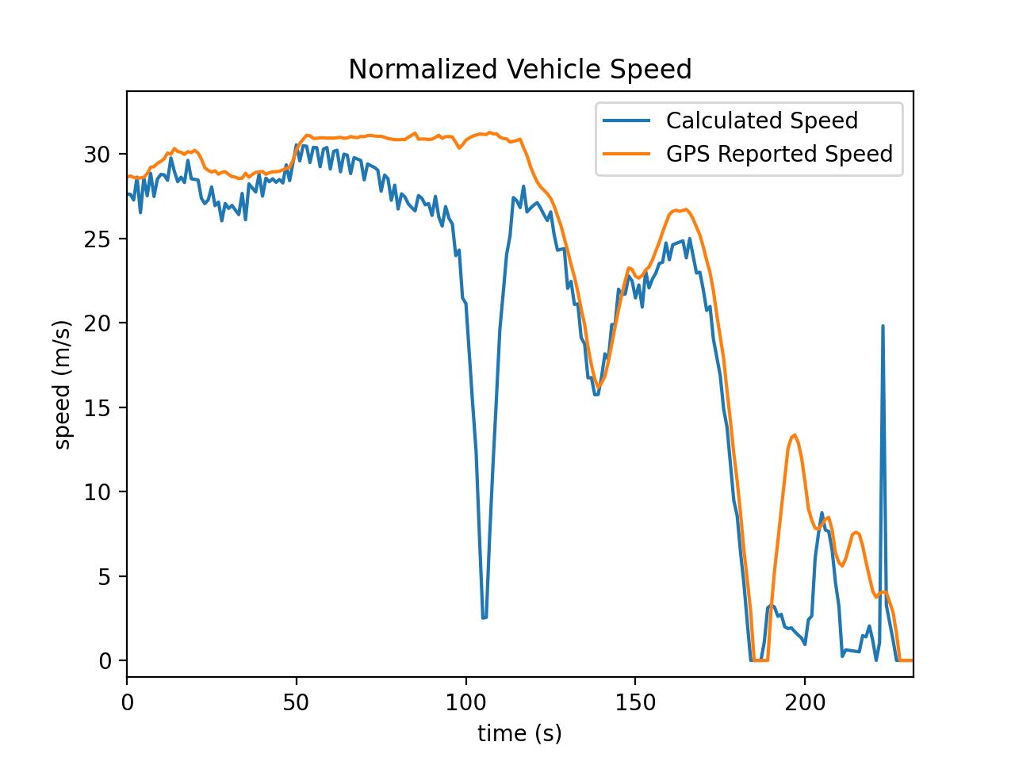
Results

